Slide 1

Compatibility Calculator
Aastha Jha, Devina Sen, Varsha Sundar

Slide 2

Our Project
High Level Description
A prediction tool to evaluate compatibility between two people using marriage datasets, user background, and horoscope information in order to provide a compatibility score + holistic report. .
Potential Users
Teenagers/young adults that are interested in exploring romance and the longevity of relationships.
Dating apps seeking to improve their algorithm in filtering profiles
Match Seekers
Notes:
Devina
Partner:
Username
Gender
Birthday
Survey:
Political affiliation
Education
Drink/Smoke/Party?
Income
Location
Religion
Same race/different race as partner?
Premarital sex?
Do you keep your emotions to yourself?

Slide 3
User Perspective
Top 3 User Requirements
Accuracy
Personalization
Presentation
Notes:
Aastha

Slide 4
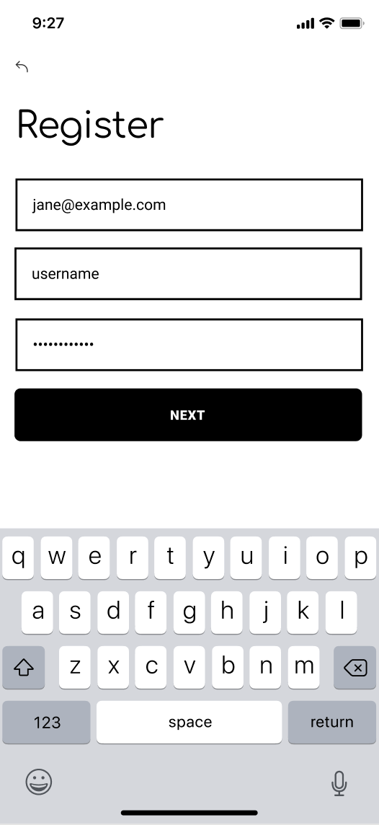
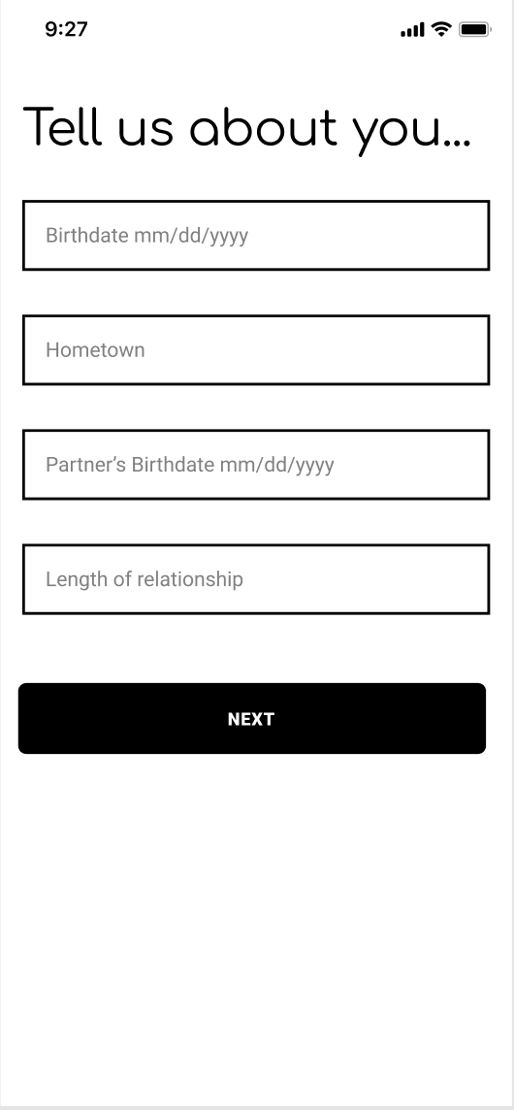
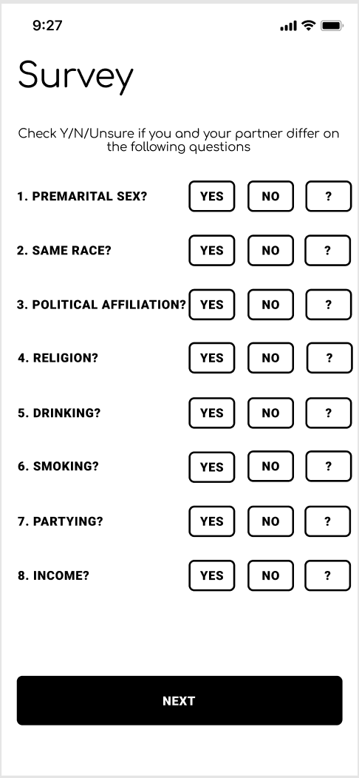
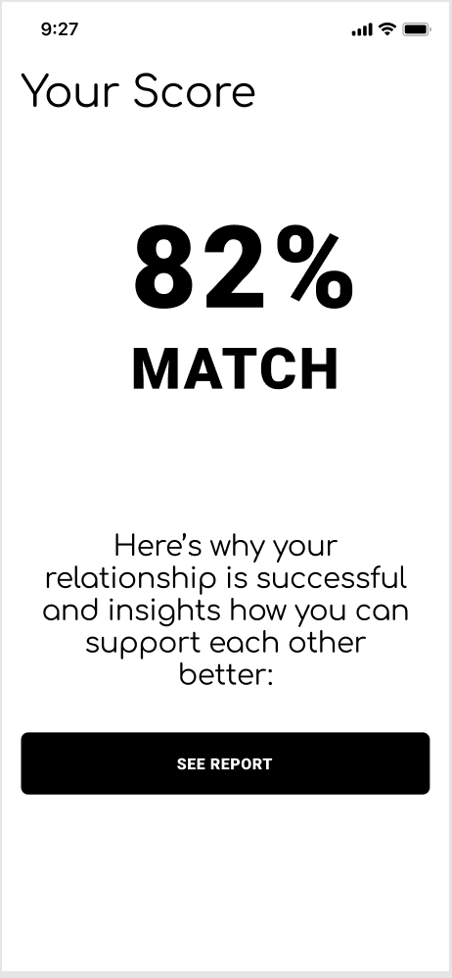
INPUT
OUTPUT

Slide 5
Technical Components
In order of importance
1
Clean marriage data set
2
Feature engineering
3
Choose prediction model
4
Cross-validation
5
User Interface
Notes:
Varsha

Slide 6
Sample Architecture
INPUT
MODEL
OUTPUT
A dating app user profile
Possible Models for Prediction & Classification:
Logistic Regression
Random Forests
Clustering
Feature Extraction
Horoscope
User data
Interests/ Opinions
Use PCA
Error
Error rate
Regularization
Compatibility score
Horoscope information
Report on user “type” & preferences
Marriage records
Notes:
Varsha

Slide 7

Next Steps
Set up collaborative workspace (ie. GitHub, Colab)
DS
Clean dataset
DS, AJ
Feature Selection
VS, DS, AJ
Cross Validation
VS, DS, AJ
Prediction Model #1
VS, DS, AJ
Notes:
Devina

Slide 8
Thank you!

Slide 9
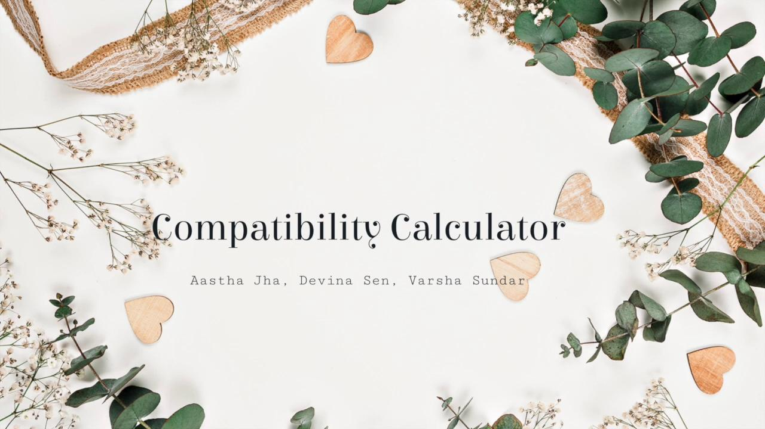
Low Tech Demo - Screencast
Notes:
https://www.youtube.com/watch?v=EULCvYQGXPo&feature=youtu.be
Screencast can also be viewed at the link above^

